Slide 1

Notes:
JZH Coaching service offering slide: Cover

Slide 2

Notes:
JZH Coaching service offering slide: Meet Jesmine

Slide 3

Notes:
JZH Coaching service offering slide: What JZH Coaching Helps Clients Achieve

Slide 4
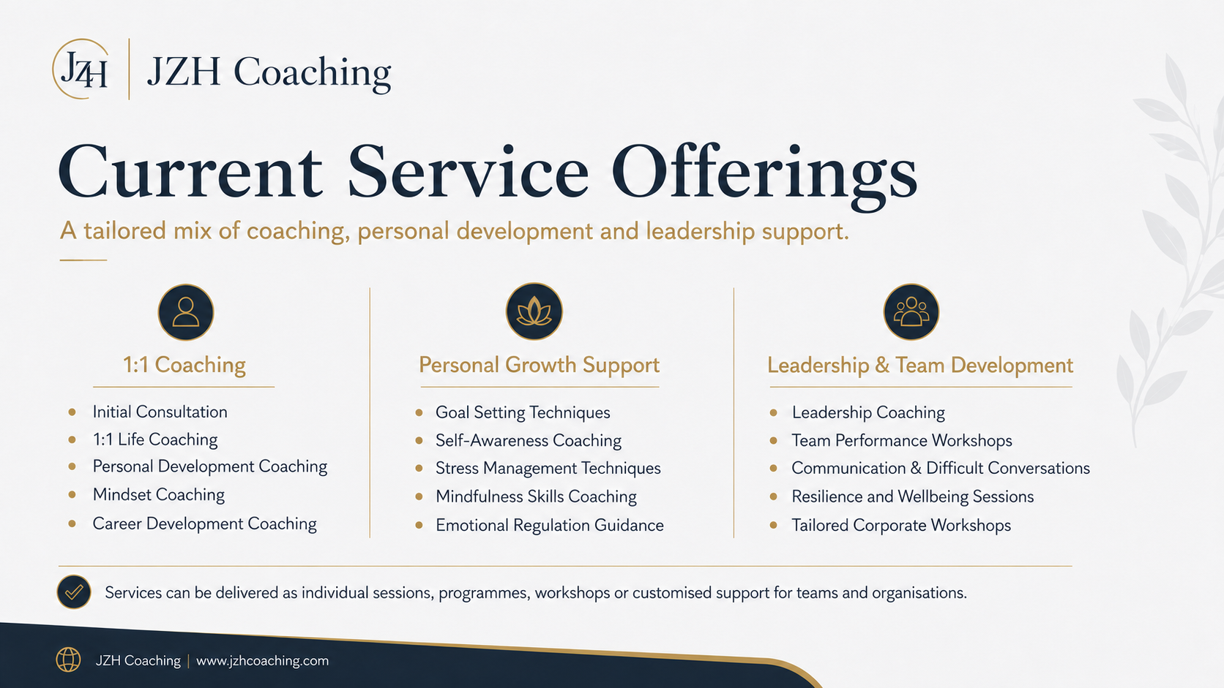
Notes:
JZH Coaching service offering slide: Current Service Offerings

Slide 5

Notes:
JZH Coaching service offering slide: Recent Coaching Themes

Slide 6

Notes:
JZH Coaching service offering slide: Who I Work With

Slide 7

Notes:
JZH Coaching service offering slide: Why Partner with JZH Coaching

Slide 8

Notes:
JZH Coaching service offering slide: Let’s Start the Conversation

